Slide 1
Rstudio basics: common issues with RMD

Slide 2
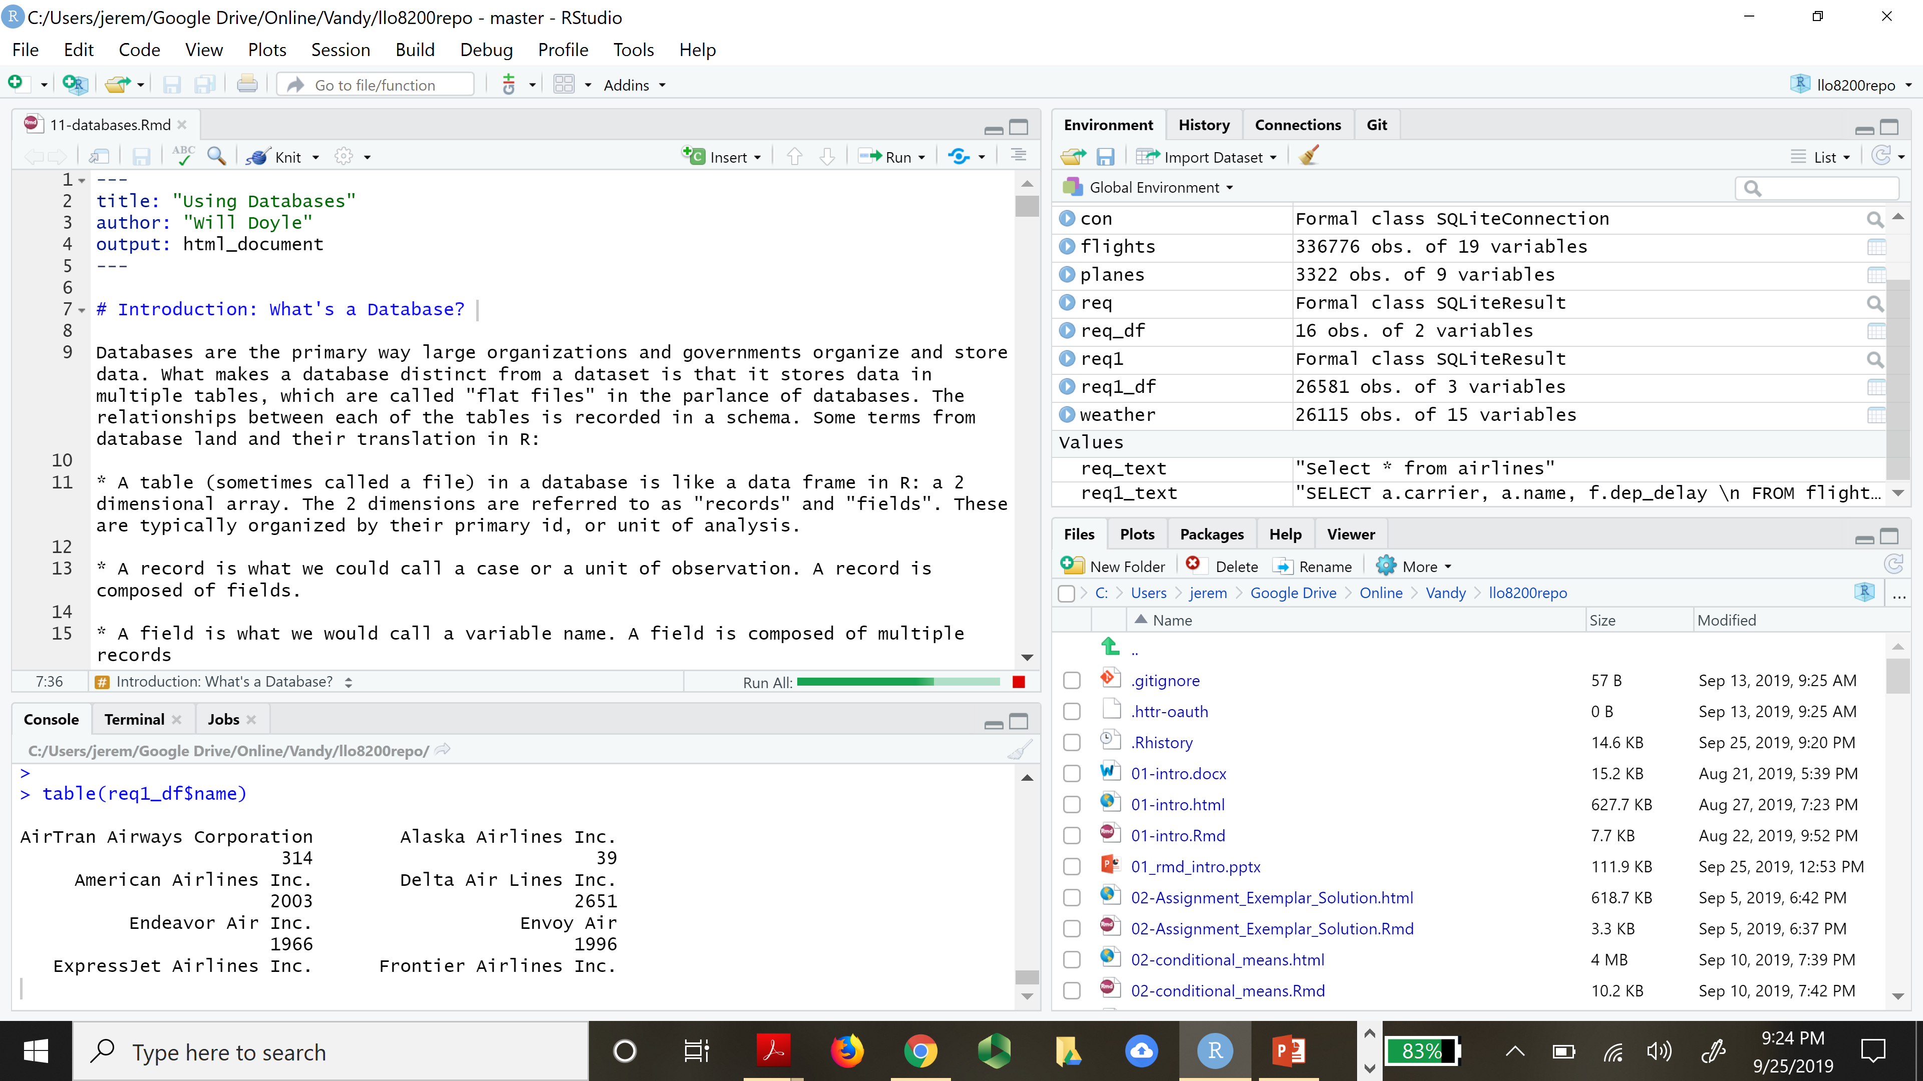
Rstudio Interface
Interpreter
Executes R code
Interface
Split into quadrants
Viewer
Environment
Console
Files / Directory

Slide 3
Viewer vs console
Viewer vs Console
Files vs console
Command prompt

Slide 4
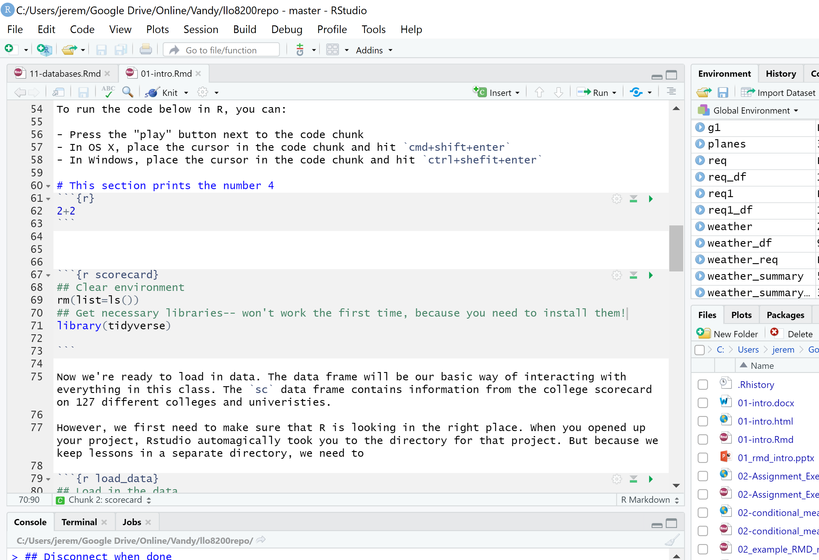
R vs rmd
RMD
R-chunks
Plain Text
Formatting
See knit tutorial
Execution
Run
Run by chunk

Slide 5
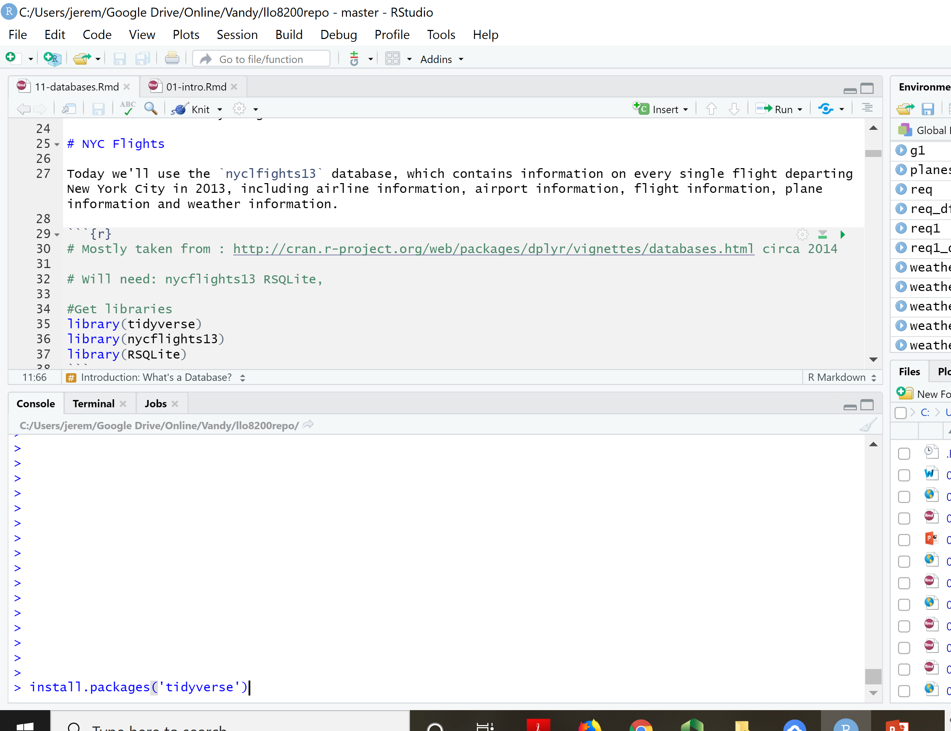
Installing vs loading packages
Packages
We will use many packages throughout the term
Each package will need to be installed once
Each package to be used must be loaded prior to each use
Example
Install tidyverse
Load tidyverse

Slide 6
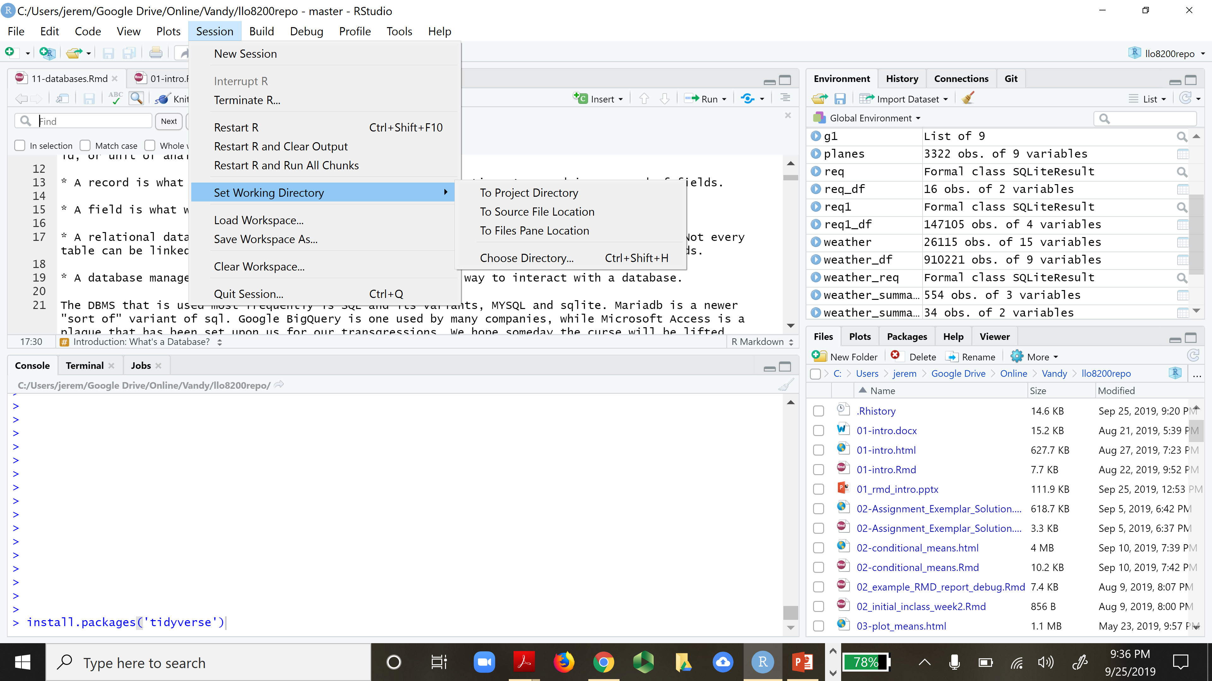
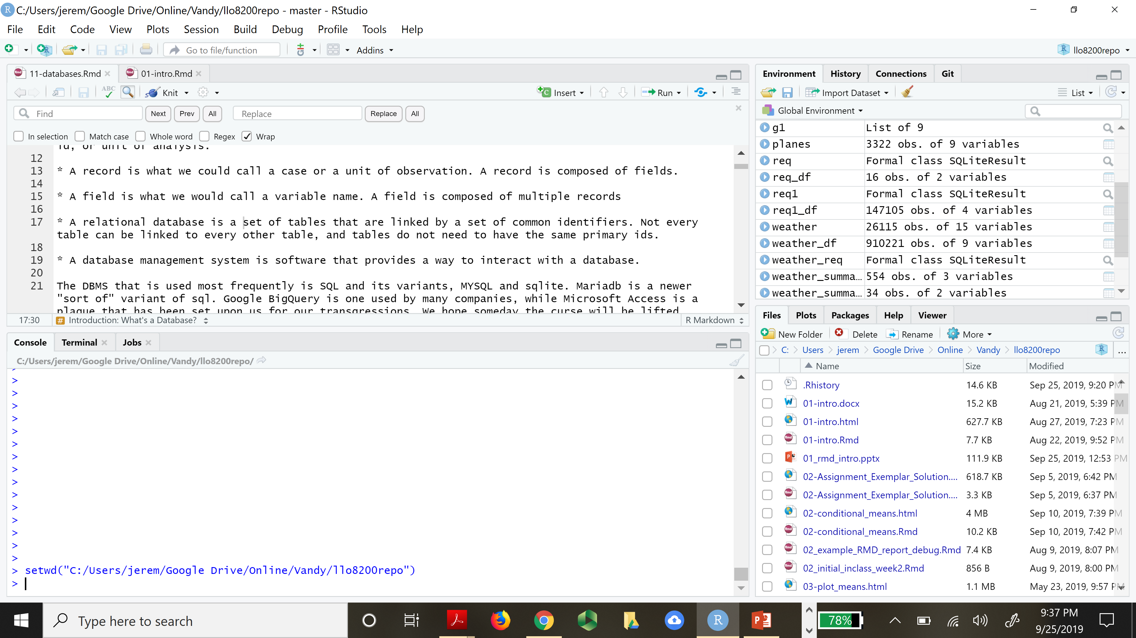
Working directory
The working directory is the folder where you executing program has access
To read files
Load data
Write files
etc

Slide 7
Pipe operator
On Mac OS X if you use RStudio or R from the terminal, you must have a copy of XQuartz, the X11 window manager, installed. This is no longer a default install since Mac OS X 10.8. You need to install XQuartz. Logout and login for the installation to take effect.
You can get it from https://xquartz.macosforge.org/landing/.
This page is also linked from the Download R for (Mac) OS X page.
Pipe Operator: %>%
Common issues / fixes
update tidyverse
mac users: install xquartz

Slide 8
Trouble shooting
Troubleshooting and debugging is part of the programming experience. I cannot help you overcome all obstacles; instead, you will learn to be self-sufficient.
Read the error messages – they can be very useful
What lines are mentioned?
What key words are mentioned?
Check the console
Error messages are here
Assess the state of execution

Slide 9
Knitting RMD files
Knitting RMD Files
Compiles RStudio Markdown files into a Word, HTML, or PDF
Common Issues
I/O
Remove I/O if possible, otherwise you may not be able to knit … which is OK
View()
Fix: Simply remove or comment out this code as it is for viewing only
Xquartz (Mac)
Install and run xquartz
See tutorial posted.
R-Chunk Labels must be unique!!

